Slide 1


Early Childhood Education and Care Department
Cabinet Secretary Elizabeth Groginsky
Family Nutrition Bureau
Summer Food Service Program for Children
Notes:
Acknowledge: Governor, Dr. Scrase, Sec. Stewart
Thank you, Secretary Stewart – and thank you, Governor, for the chance to share an update on child care and other early childhood programs in New Mexico.
NEXT SLIDE

Slide 2

Meals served away from approved locations – formerly Field Trips in the SFSP
During the summer some sites such as community centers or summer school programs offer field trips to participants. The Sponsors must remember to conduct meal services for field trips within SFSP regulations to receive reimbursement for meals served away from the approved locations.

Slide 3

SFSP Regulation 7CFR, Part 225.16(g)
…allows sponsors the option to receive reimbursement for meals served away from approved locations when the following conditions are met.
Please note the following slides:

Slide 4
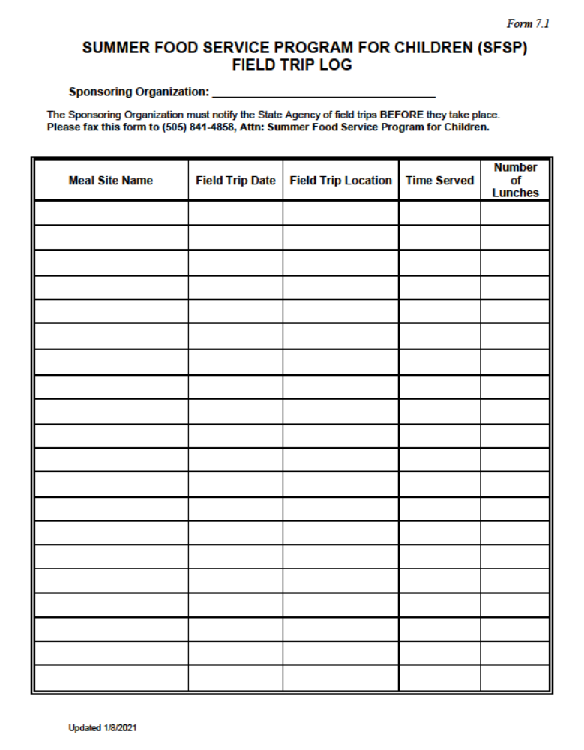
Condition 1 –
State agency notification
Form 7.1- Summer Food Service Program for Children (SFSP) Field Trip Log
This form must be completed and submitted to the state agency prior to the date of the field trip.
The form is located at: summerfoodnm.org/sponsors and can be downloaded and submitted electronically to the state agency.

Slide 5
Condition 2 –
Meet program Requirements and health and safety standards.
Sponsors must meet all program requirements including applicable State and local health, safety and sanitation standards.
Meals that are being transported for field trips need to be kept at appropriate temperatures to ensure food safety.
Condition 3 -
Approved Mealtimes
Meals served away from approved locations must follow the same approved mealtime as the open site.
Notes:
Site Supervisors remain responsible for children’s loose trash.
Sponsor remains responsible for trash disposal at all of its sites.
Children must be where the site supervisor can see them at all times

Slide 6

Condition 4 -
Site must remain open
Sponsors of open sites must continue operating at the approved location and operate for approved mealtimes.
This allows participants within the service area to still receive meals.
Notes:
Children must be where the site supervisor can see them at all times

Slide 7
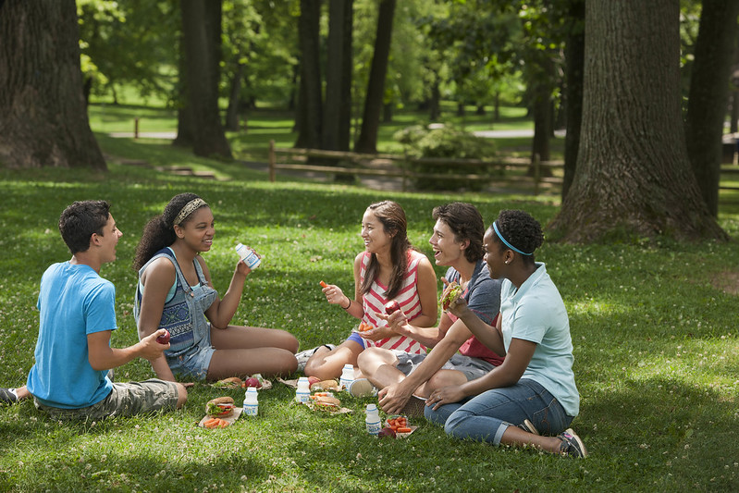
Reminder
The Field Trip Log MUST be completed and submitted PRIOR to the date of the field trip.
Verbal notifications or emails received the day of the field trip will not be accepted.
Notes:
Any meal service time changes require prior approval from the state agency. These changes are requested in EPICS and approved by Emiliano.

Slide 8
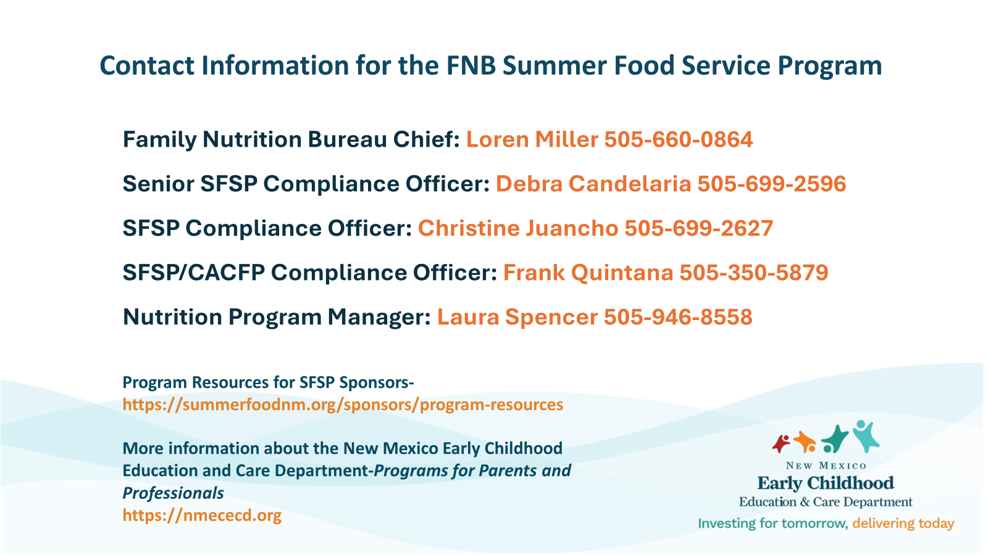

Slide 9
